Slide 1
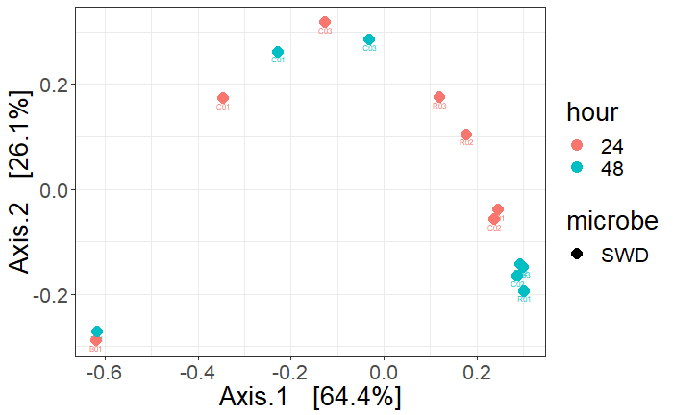
Blanks
Controls
Replicates

Slide 2
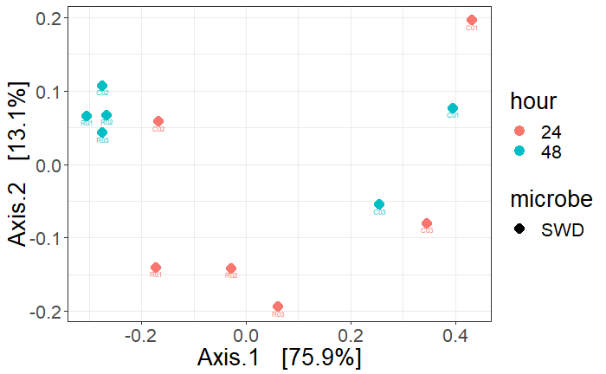
Controls
Replicates

Slide 3
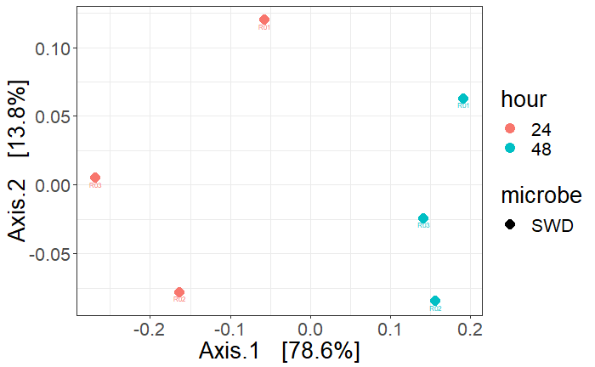
Replicates
ONLY

Slide 4
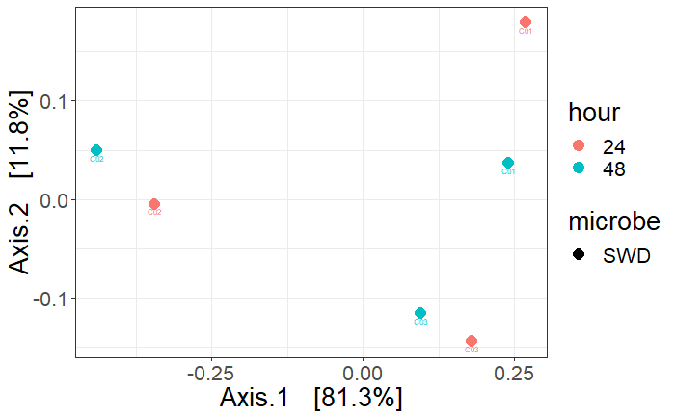
Controls
ONLY

